Slide 1

Music Industry Analysis with Spotify
BIG DATA CAPSTONE PROJECT
Abhishek Mishra (anm9189)
Lakshana Kolur (lk2719)
Shreeraj Pawar (srp8095)

Slide 2
Problem Statement
Imagine wanting to get started in the music industry.
You believe you have a skill for spotting great talent and promoting them to become stars.
Yet, apart from your ingenious ability, you need to be familiar with facts.

Slide 3
What do we want to know?
I am on top of the charts for now, but for how long?
How has the pandemic affected popularity in the US?
What is happening around the world?
What is the trend of songs in the Top Charts?

Slide 4
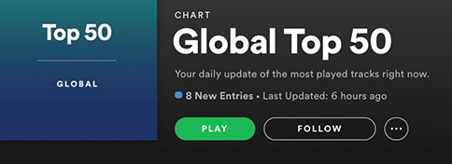
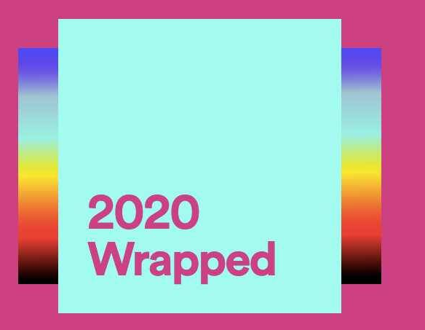
About our data
Spotify releases Top 200 Charts & Viral 50 Charts every 2 days. This can be accessed using Spotify APIs. It gives us information about:
Regions where the charts are topping - Argentina, Paraguay, Global, United States
Various artists along with their titles
Total amount of data: 3.48GB

Slide 5
Why Big Data?
Data is updated every 2 days, it keeps accumulating and its not possible to use the single node solutions for analysis.
As the number of years increase, the scale of the data increases
To perform analysis with machine learning, with larger number of features, we would need Big Data infrastructure

Slide 6



Architecture

Slide 7
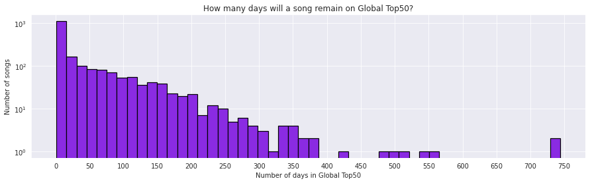
I am on top. But for how long?
How many days does a song stay in Global Top50?
As we expected most songs were there just about one or two months (notice the logscale on the y-axis). There are some songs which were on Global Top50 for over two years!!
Notes:
Some songs appear in the Global Top50 for a few days, but some hit songs are there like ... forever.
For example, I remember Ed Sheeran's Shape of You was always in the Global Top50 list
Get top 50 for each day, # of streams, sum of streams

Slide 8
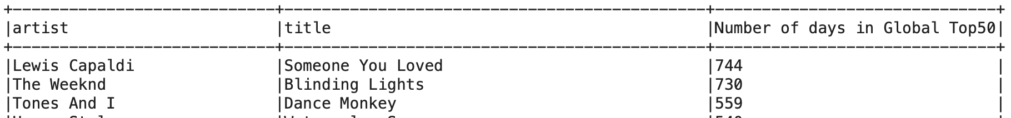
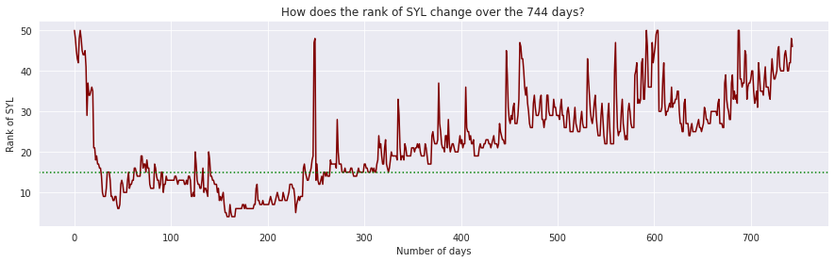
I am on top. But for how long?
Which songs are these?
It’s been in the top charts for over 2 years - but how does the rank change over time?
Notes:
At about 325-350 days (~ 1 year), the song's rank started dropping to mid-range ranks - around 25
But this plot looks kinda messy, doesn't it? Perhaps we could look at moving monthly averages for rank, instead of daily rankings.

Slide 9
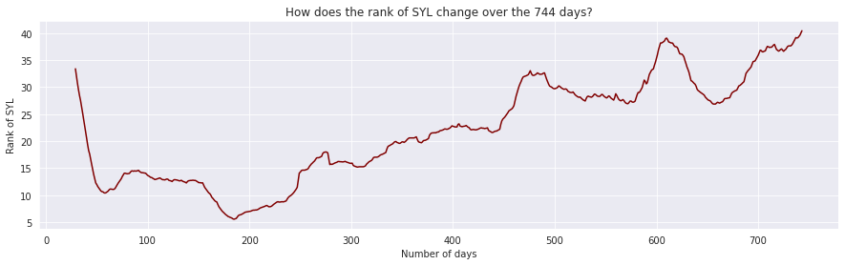
I am on top. But for how long?
Better visualization
Started off with rank #33
Reached peak ~200 days
Decrease after ~300 days
Notes:
Better visualization with rolling means for monthly averages
The song came out in 8 Nov, 2018.
Song started off with rank 33 when it was released -
reached peak popularity after around 200 days of its release which is surprising.
But never came below rank 5
And had a steady decrease after 300 days here with consistent highs and lows.

Slide 10
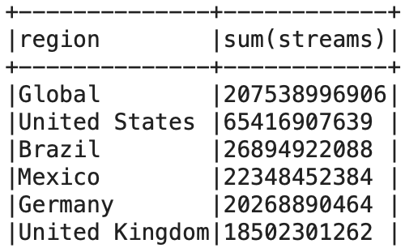
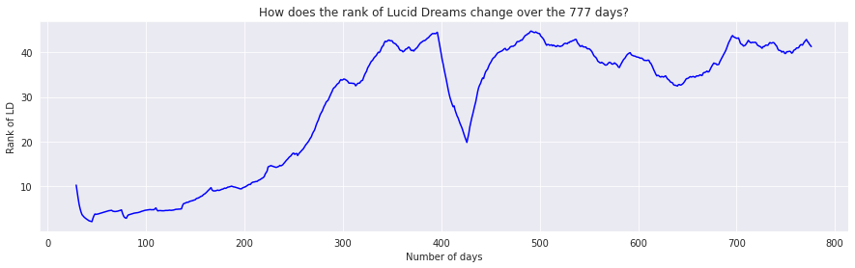
I am on top. But for how long?
Look at different regions - how does this compare to Global Charts?
Lets look at United States next :
Started off with lower ranks, reached peak early
Compared to Global peak ~200day
Songs become popular quickly locally, than globally
Notes:
Found all regions - 69 - too many
so finding the ones with the most streams - most population or rather, most no of people streaming music
Compared to global charts - started off with lower ranks and then gradually becoming less whereas for global charts, it peaked around 200day-mark.
This is because for global charts - the songs need to become popular for their region first and then slowly become popular globally.

Slide 11
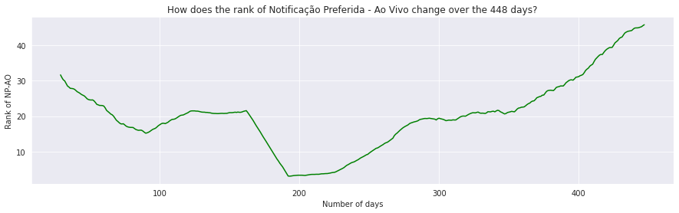
I am on top. But for how long?
Look at different regions - how does this compare to Global Charts?
Lets look at Brazil next :
Portuguese song is top (as expected)
448 days top charts soaring
Same as Global peak ~200day

Slide 12
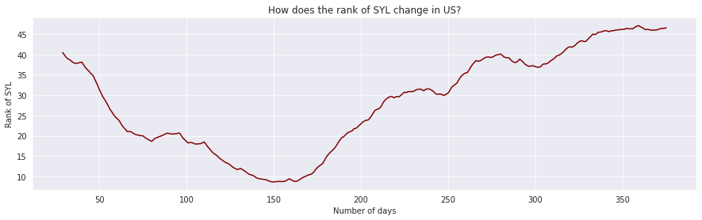
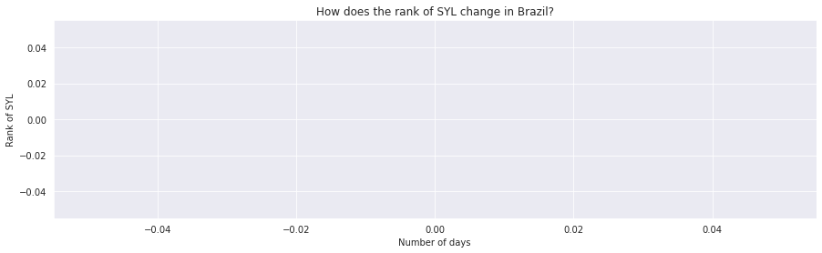
I am on top. But for how long?
Conversely, how does ‘Someone You Loved’ do in US and Brazil?

Slide 13
2. How is the Pandemic affecting popularity in the US?
We wanted to explore the effects of the COVID 19 Pandemic on the top charts and how it has affected the popularity of songs and artists in the US.
For this we followed an approach where we examine the trends of populars songs during the pandemic.
We see the trend of the top 3 songs in US in three different time periods - pre pandemic, post pandemic and during pandemic.

Slide 14
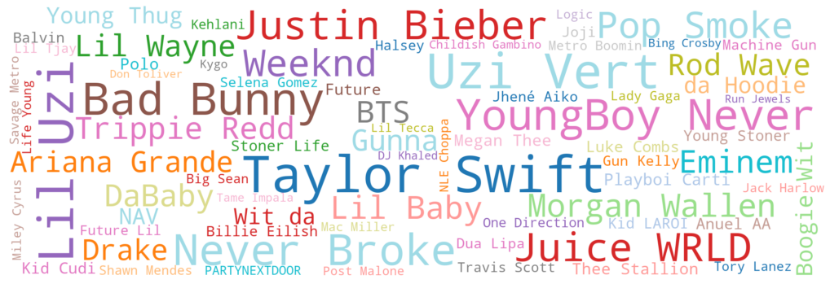
US Pandemic Artists Word Cloud

Slide 15
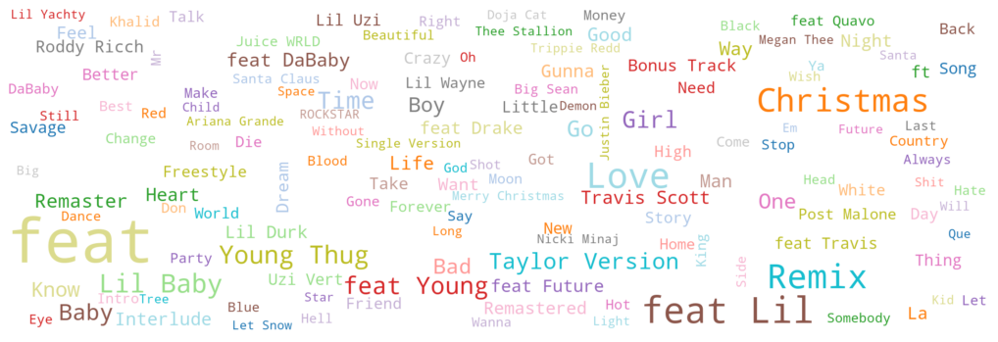
US Pandemic Songs Word Cloud

Slide 16
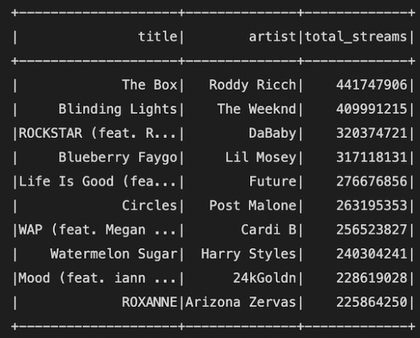
Top 10 Songs in US during Pandemic
As we can see from above The Box and Blinding Lights and ROCKSTAR were the most streamed songs in United States during the pandemic period.
Now, let’s explore the popularity of these songs before pandemic, during the pandemic and after pandemic

Slide 17
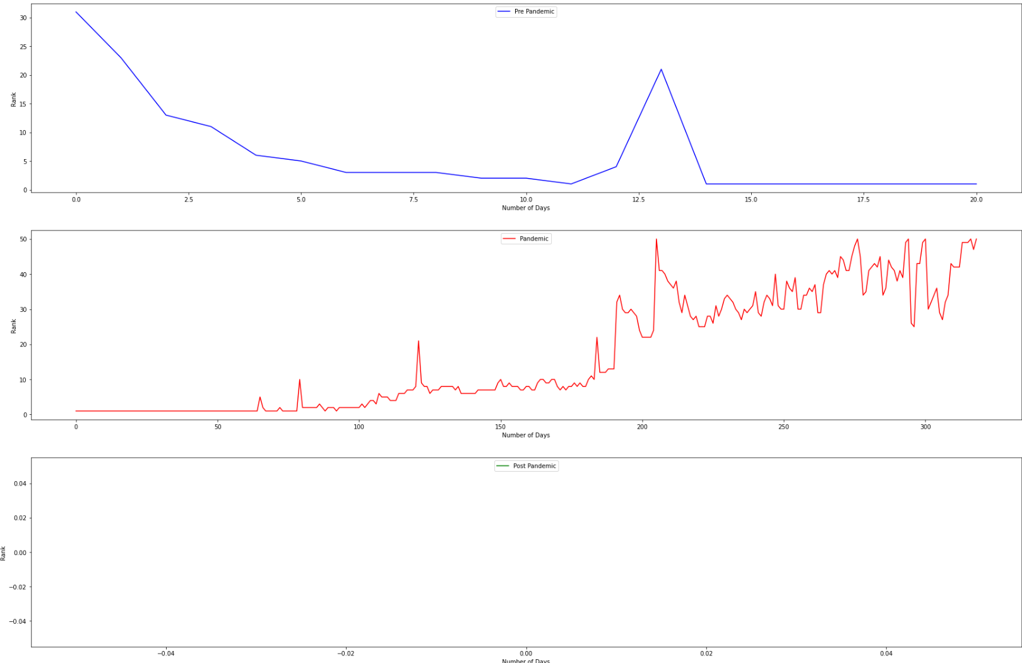
Trend for ‘The Box’ by Roddy Ricch

Slide 18
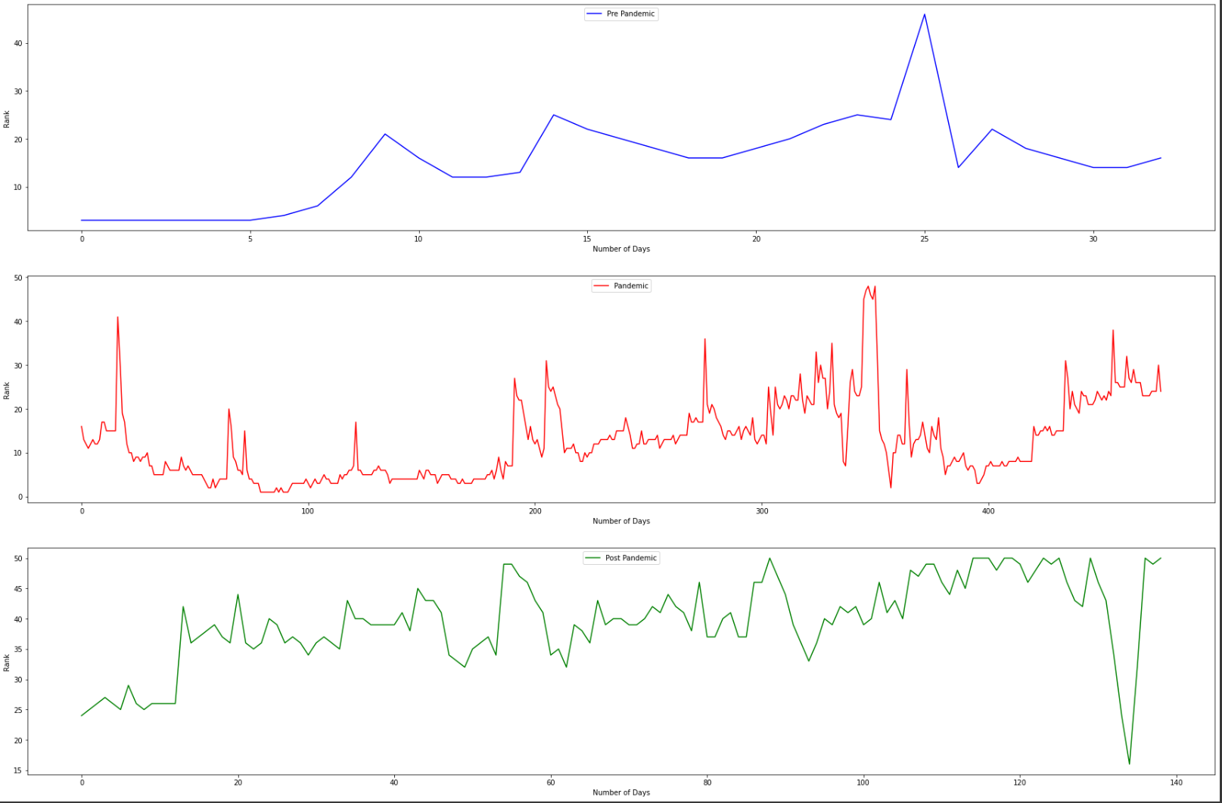
Trend for ‘Blinding Lights’ by The Weeknd

Slide 19
The previous analysis was for the United States and we noticed that lot of the singers were rappers and highly streamed songs during this time was the rap and hip hop genre. This hints at a possible return to rap and hip hop culture during the tough times of the pandemic in the United States.
Let's see the case globally as to which artists are dominating and where are they most popular. Initially let's compare the top 3 pandemic artists and get their global ranks in terms of number of streams.
Artists | Global Rank
The Weeknd | 1
DaBaby | 15
Roddy Ricch | 20

Slide 20
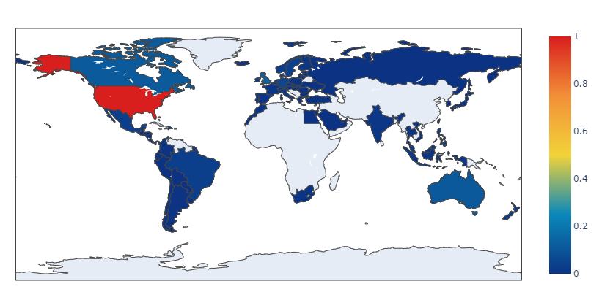
3. Around the World
We wanted to explore the influence an artist has over the world.
The artist of choice was Post Malone.
Post Malone is an American rapper, singer, and songwriter. Known for his introspective songwriting and
variegated vocal styles.
The choropleth shows Post Malone has more influence in America which is plausible being born in American.

Slide 21
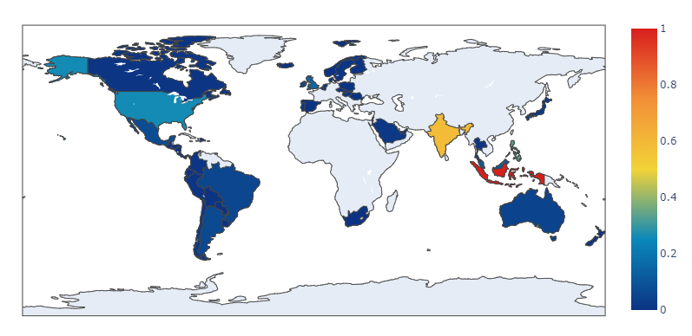
3. Around the World
Let see if region of origin affects the influence of an artist.
Artist here would be One Direction.
One Direction, often shortened to 1D, are an English-Irish pop boy band formed in London, England in 2010.
Here we see a different trend here. A rather conflicting one than the previous.

Slide 22
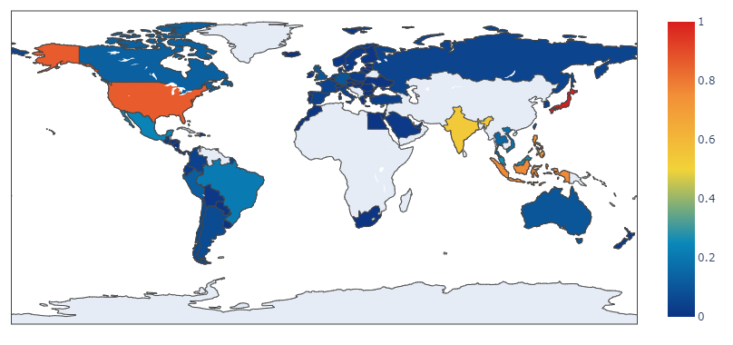
3. Around the World
Till now the artist were producing songs in English which is in International Language.
Lets see if language plays an important role in on the influence of an artist
We look into BTS here.
BTS, also known as the Bangtan Boys, is a South Korean boy band that was formed in 2010. Majority of their songs are in Korean.
It is evident that language do not affect the fan base or the influence of an artist over the world

Slide 23
4. What is the trend of songs in the Top Charts?
Leveraged Spark ML Library to apply ML techniques.
One of the use cases for ML : Using Logistic Regression to do multi- class classification on the trend column.
Trains the model based on the rank and number of streams column while using trend (MOVE_UP, MOVE_DOWN and SAME_POSITION) as a label.
The model can be used to predict future values on the trend of a particular songs based on the rank on that date and number of times it was streamed on that day.

Slide 24
Mariah Carey Christmas Spirit
Mariah’s Carey famous song “All I Want for Christmas is You” is an all time holiday classic and we wished to explore the trends based on our trained model.
For our first prediction we assume our song has a rank of number 63 and streams as 68087 and we get a trend of “MOVE_DOWN”.
For values of rank number 4 and stream number 3489570 we get a trend of “SAME_POSITION”

Slide 25
Proposed Improvements to ML Model
We can incorporate region into the prediction as we notice that trend depends on the region too.
In the Christmas of 2018 Mariah Carey’s “All I want For Christmas is You” was ranked number 63 in India as Christmas is not such a big festival in India and access to Spotify was limited at that time.
However at the same time in United States we obtain a rank of 4 and a trend of “SAME_POSITION” as Christmas Spirit is on full swing during this time.

Slide 26
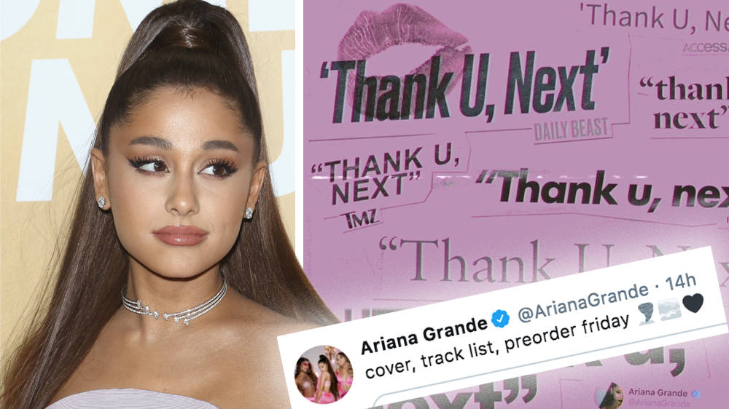
thank you, next

